Slide 1
2023-03-10

Slide 2
Interfaces

Slide 3
Interfaces
Languages like Python and C++ support multiple inheritance: Classes can inherit from multiple base classes.
Java has single inheritance. A class can only declare a single superclass.
However, Java has another feature called interfaces, which is similar to multiple inheritance.
A class extends only one superclass, but it implements zero or more interfaces.
Interfaces used to be on the AP Computer Science exam, but were removed in 2017. So, consider this bonus content.

Slide 4
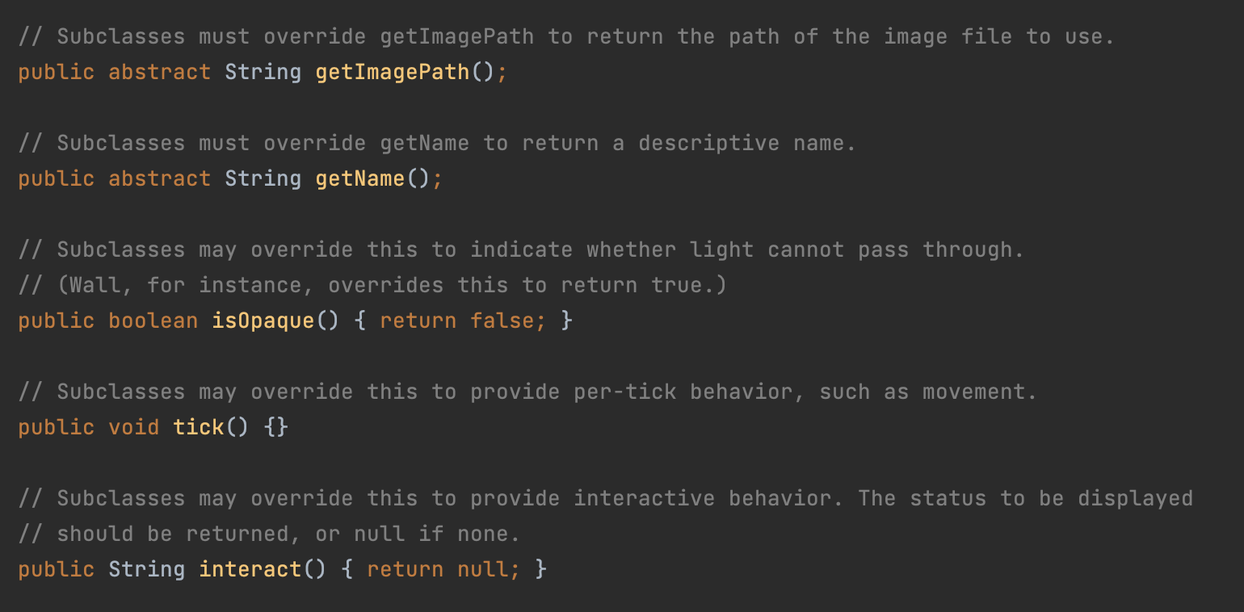
Abstract classes are "incomplete"
MazeObject is an abstract class – it cannot be instantiated itself. It has abstract methods which must be implemented by a subclass to "complete" the class, like getImagePath.

Slide 5
Interfaces
/**
* The listener interface for receiving KeyEvents.
*/
public interface KeyListener extends EventListener {
/**
* KEY_PRESSED events are fired when any key (including a function
* key and cursor key) is pressed while the component has keyboard
* input focus.
* KeyEvent.getKeyCode() can be used to find out which key was pressed.
*/
void keyPressed(KeyEvent ke);
/**
* KEY_TYPED events are fired when a key representing a valid text
* character (not a function key or cursor key) is pressed.
* KeyEvent.getKeyChar() can be used to get the ASCII code of the key
* that was pressed.
*/
void keyTyped(KeyEvent ke);
/**
* KEY_RELEASED events are fired when a key is released.
*/
void keyReleased(KeyEvent ke);
}
An interface declaration looks much like a class declaration.
The big difference is the methods have no bodies.
This is similar to abstract methods like MazeObject.getImagePath.

Slide 6
Interfaces
/**
* The listener interface for receiving KeyEvents.
*/
public interface KeyListener extends EventListener {
/**
* KEY_PRESSED events are fired when any key (including a function
* key and cursor key) is pressed while the component has keyboard
* input focus.
* KeyEvent.getKeyCode() can be used to find out which key was pressed.
*/
void keyPressed(KeyEvent ke);
/**
* KEY_TYPED events are fired when a key representing a valid text
* character (not a function key or cursor key) is pressed.
* KeyEvent.getKeyChar() can be used to get the ASCII code of the key
* that was pressed.
*/
void keyTyped(KeyEvent ke);
/**
* KEY_RELEASED events are fired when a key is released.
*/
void keyReleased(KeyEvent ke);
}
Interfaces are like abstract classes, except ones where every method is abstract.*
An interface is a contract that a class has to implement completely.
If a class implements KeyListener, it must implement keyPressed, keyTyped and keyReleased, or it's a compile error.
*Mostly true. Default interface methods added in Java 8 (2014)

Slide 7
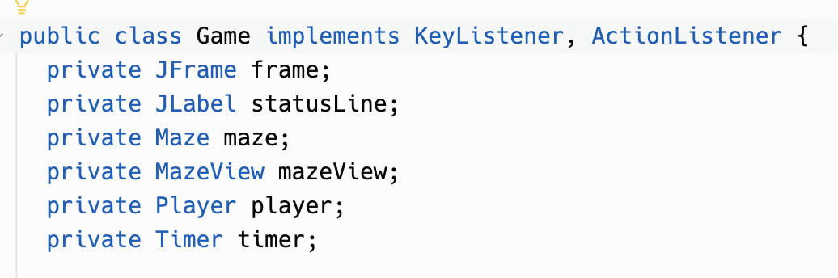
Game implements interfaces
Look at Game.java. Note that it doesn't declare any superclass, so the superclass is Object. It implements two interfaces, though: KeyListener and ActionListener.

Slide 8
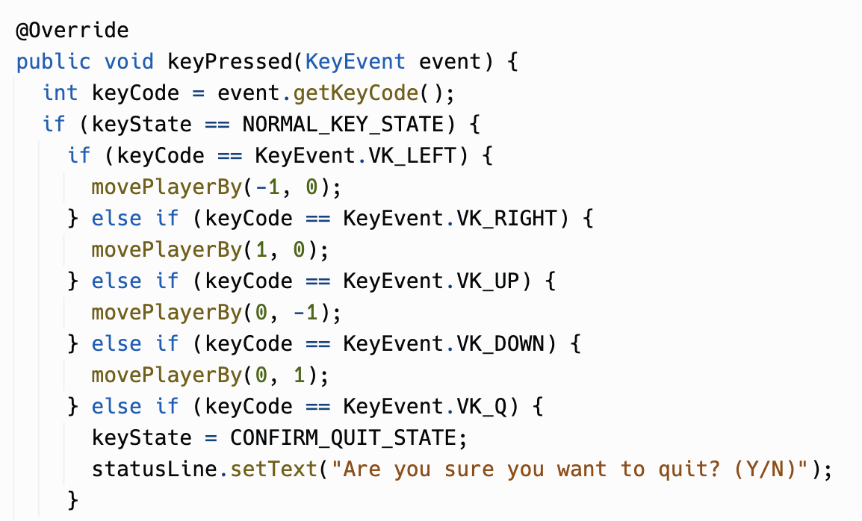
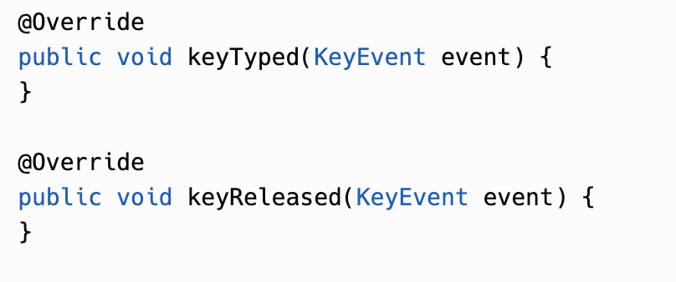
Game's KeyListener methods
Because Game implements KeyListener, it must implement keyPressed, keyTyped, and keyReleased methods. We only cared about keyPressed, but we had to supply something for the other two.
There is a fancy-pants way to avoid the empty methods, an abstract class called KeyAdapter + anonymous inner classes.
Java 8 (2014) did add "default interface methods" (which have bodies)

Slide 9
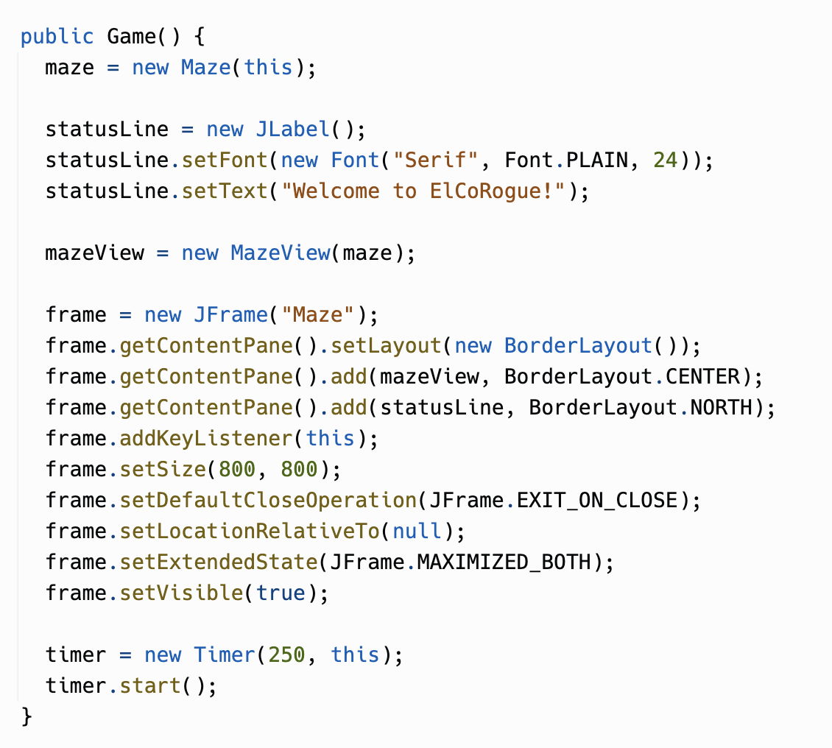
Game's call to addKeyListener
Game registers itself with Java Swing as a key listener by calling addKeyListener on the JFrame that is the game's main window.
The addKeyListener method takes a parameter of type KeyListener. Interfaces are types!
Because Game implements KeyListener, it can be cast to KeyListener.
// Legal. KeyListener k = (KeyListener)game;

Slide 10
Game's ActionListener
The game "ticks" every 1/4 second, giving every MazeObject a chance to do something.
This is done using a class called java.swing.Timer.
You create a Timer, and register an ActionListener with it. The ActionListener's actionPerformed method will be called every time the timer goes off. (The 250 is milliseconds for 1/4 of a second.)

Slide 11
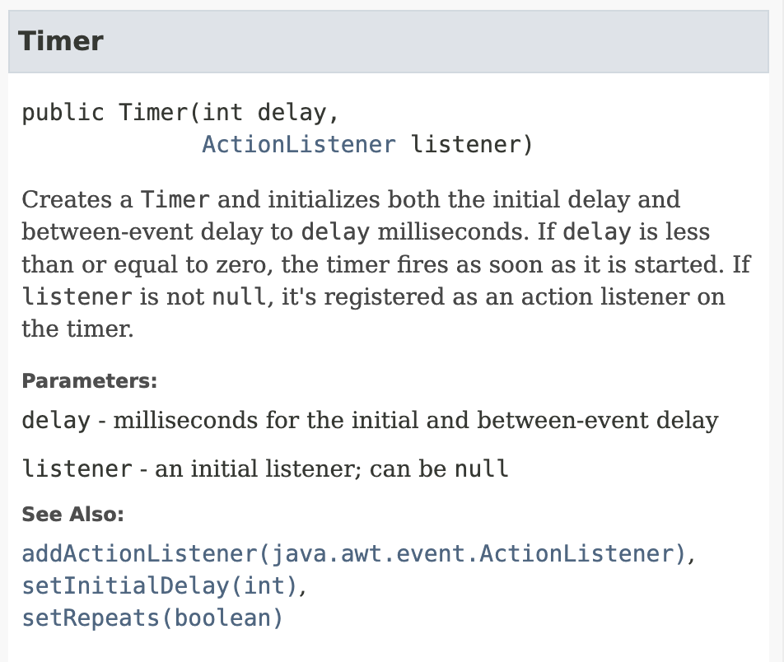
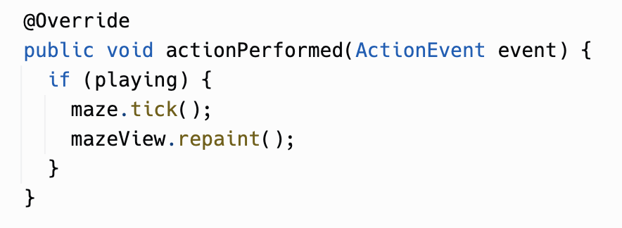
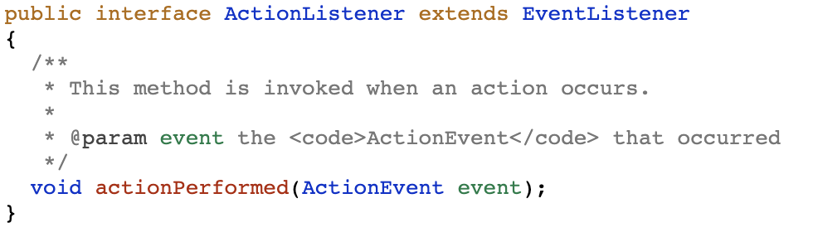
Game's ActionListener.actionPerformed method

Slide 12
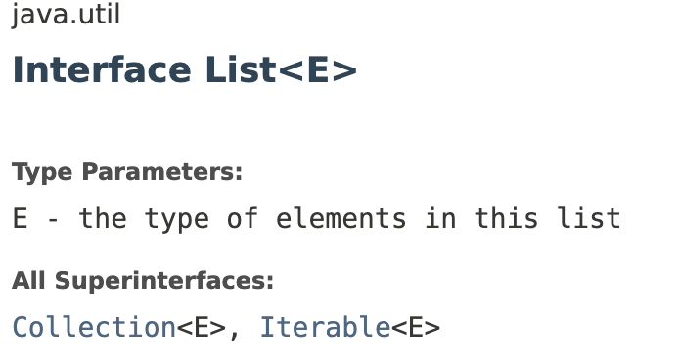
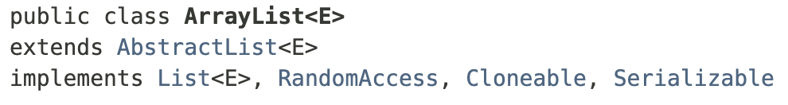
List and ArrayList
You know how you occasionally see code like this?
List<String> list = new ArrayList<String>();
So, List must be a superclass of ArrayList, right?
Actually, List is an interface which ArrayList implements!
List even has superinterfaces which are like superclasses.

Slide 13
Iterable<E>
Iterable<E>
ArrayList<E> implements the interface List<E>
List<E> extends Collection<E>
Collection<E> extends Iterable<E>
That is, Iterable<E> is a superinterface of List<E>
The for-each loop works on any object that implements Iterable<E>
This is why for-each loops work on ArrayLists!
extends
Collection<E>
extends
List<E>
implements
ArrayList<E>

Slide 14
Class Hierarchy / Interface Hierarchy
A class belongs to an inheritance hierarchy of classes. When a class implements interfaces, the class is also part of an inheritance hierarchy of interfaces.
Object
EventListener
Game game = new Game();
These are all true:
game instanceof Object
game instanceof EventListener
game instanceof KeyListener
game instanceof ActionListener
extends
extends
extends
KeyListener
ActionListener
Game
implements

Slide 15
Interfaces
In conclusion:
You don't need to study them for the AP exam, but interfaces are widely used in Java code.
Frameworks that you build applications with, like Java Swing, use them a lot.
Even the Java standard library (ArrayList and friends) uses interfaces.
So, good to know!

